Slide 1
Comprehensive Conservation &
Management Plan (CCMP)
Jen Rafter, Technical Coordinator, Maryland Coastal Bays Program

Slide 2
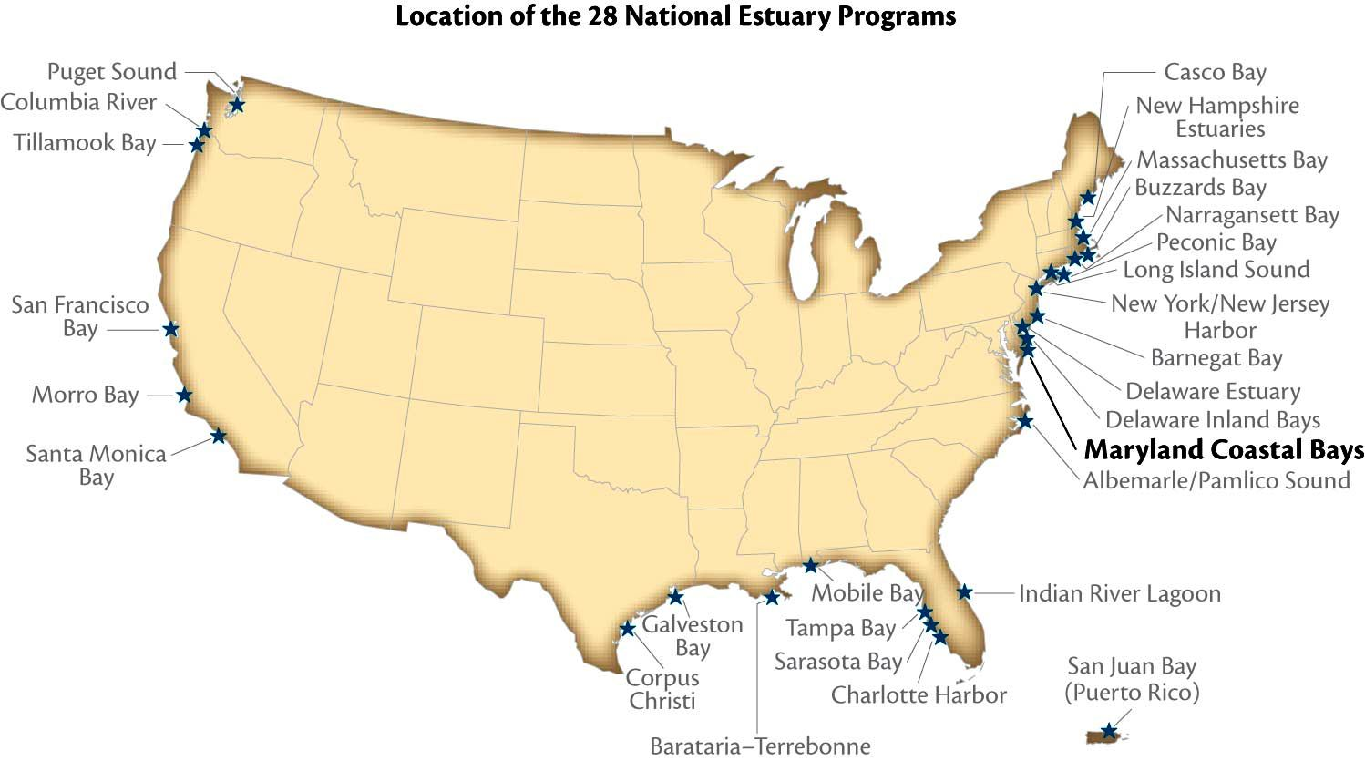
Maryland Coastal Bays Program is a National Estuary Program (NEP)

Slide 3
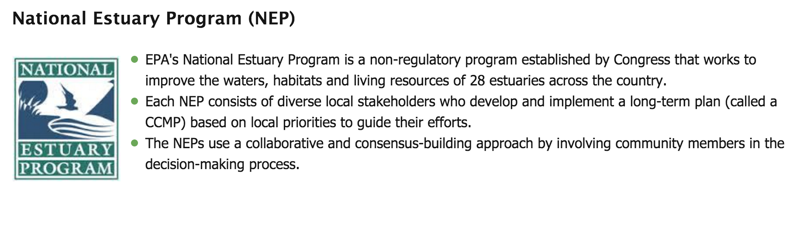

Slide 4
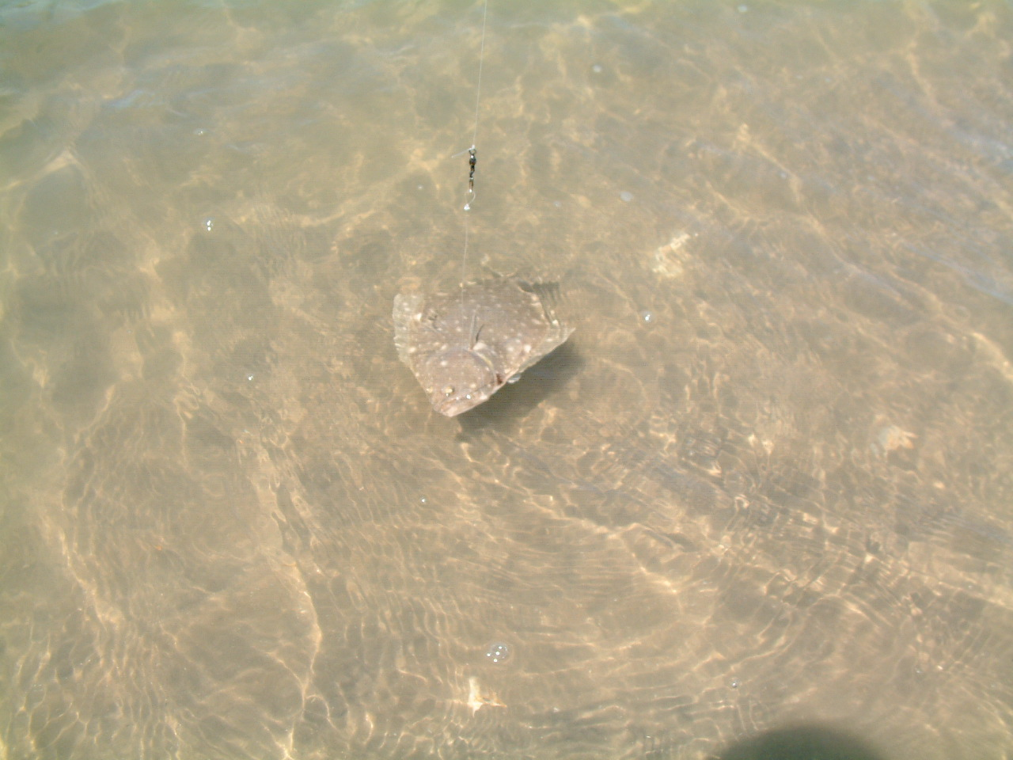
Who are our partners?
Worcester County
US Environmental Protection Agency
MD Department of Natural Resources
MD Department of the Environment
MD Department of Planning
MD Department of Agriculture
National Park Service
Town of Ocean City
Town of Berlin

Slide 5
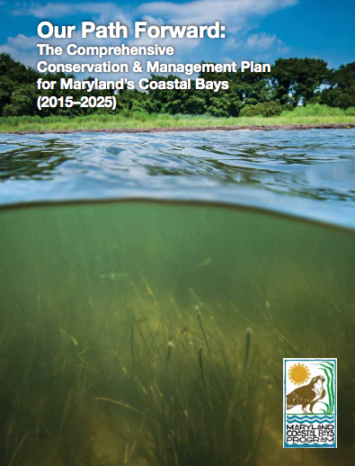
At mdcoastalbays.org

Slide 6
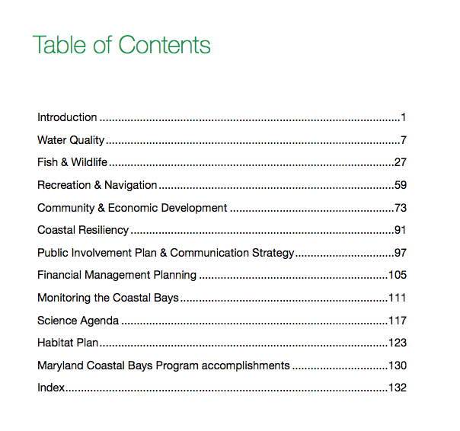
To search inside a browser, use Control F
(or in Mac, use Command F)

Slide 7
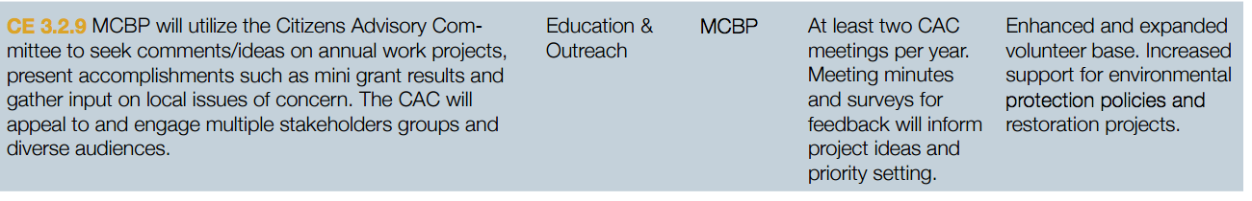
226 Actions

Slide 8
CCMP Goals
Water Quality (WQ)
WQ 1. Decrease nutrient loading throughout the watershed.
WQ 2. Decrease inputs of toxic contaminants.
WQ 3. Implement a strategy to meet TMDL reductions
Fish and Wildlife (FW)
FW 1. Characterize, monitor and manage fishery resources and habitats.
FW 2. Characterize, monitor and manage estuarine resources and habitats.
FW 3. Characterize monitor and manage terrestrial resources and habitats.
FW 4. Expand upon the coordinated effort to collect and report on Coastal Bays geomorphic and biometric information.

Slide 9
CCMP Goals
Recreation and Navigation (RE)
RN 1. Improve recreational opportunities and access to the Coastal Bays and tributaries.
RN 2. Balance resource protection with recreational use.
RN 3. Continue to implement the Ocean City Water Resources Study recommendations.
RN 4. Manage sediment alterations in a manner beneficial to the local economy and natural resources.
Community and Economic Development (CE)
CE 1. Manage the watershed to maximize economic benefits while minimizing negative resource impacts.
CE 2. Enhance the level of sustainability in land use decision making.
CE 3. Educate and inform the population so it can make knowledgeable decisions for the community and its future.

Slide 10
Tonight's presentation relates to the Maryland Coastal Bay Program's 10 year Comprehensive Conservation and Management Plan as follows:
Work with the Dept. of Natural resources to educate anglers about fishery regulations and explain responsible fishing practices (Action FW1.3.4)
Enhance public awareness of resource protection issues and needs, targeting sensitive areas and species (Action RN 2.1.3)
Working with academic, local government and other partners, analyze and promote the economic values of commercial and recreational fishing and other natural resource dependent sectors. (Action CD 1.1.1)
- Support Ocean City's sponsorship of permits for the Ocean City Reef Foundation and sustained improvements in reef enhancements. (Action FW 4.1.7)

Slide 11
Questions or comments?
Maryland Coastal Bays Program CAC contact Jen Rafter
  jrafter@mdcoastalbays.org
  410-213-2297 x 109

